Slide 1
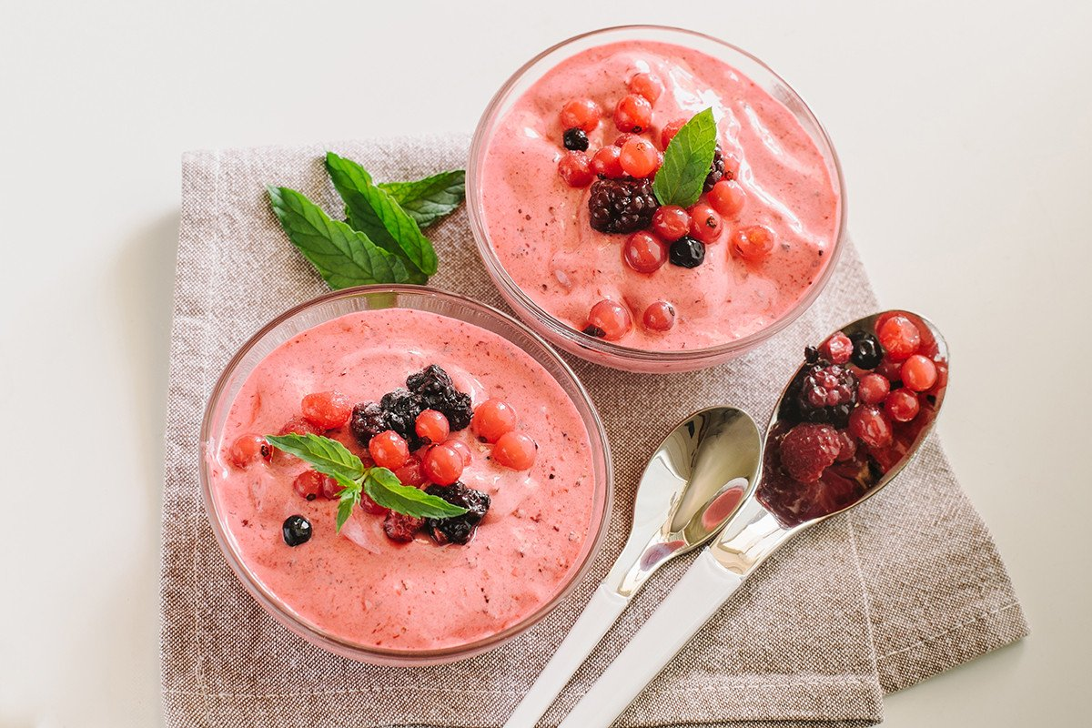

Analytics Design & Application
Case2
Recommending the new set of Flavors of Yogurt to launch in the market
Group 9:
Anjali Shastri
Futao Xie
Guchuan Qiu
Huiwen Ge
Tianbi Guo

Slide 2
Highlights & Recommendation
Goal
Launch new flavors to attract more customers to buy private label Greek yogurt.
I
“Plain” and “Vanilla” flavored rule the market. (historical data)
Finding
II
“Raspberry” and “Black Cherry” are two of the most favorite flavors by customers. (survey data)
III
The attributes of “High Protein” and “0% fat” have a high proportion.
Recommendation
“Black Cherry” should be launched as a new flavor to increase reach.
Notes:
Raspberry and Black Cherry are two of the most favorite flavors based on the survey data.
“High Protein” and “0% fat” have a high proportion in survey attributes, because we think customer would focus on their physical health.
Turf analysis的目标：compagin 我们希望爱买regular的人去买greek. 希望增加新的口味增加greek. 把goal 放在前面。

Slide 3
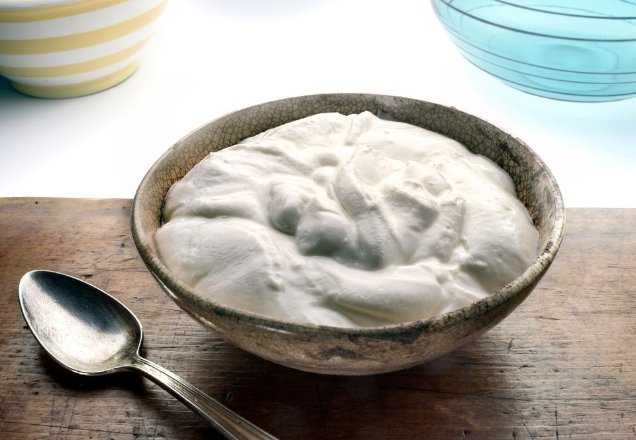
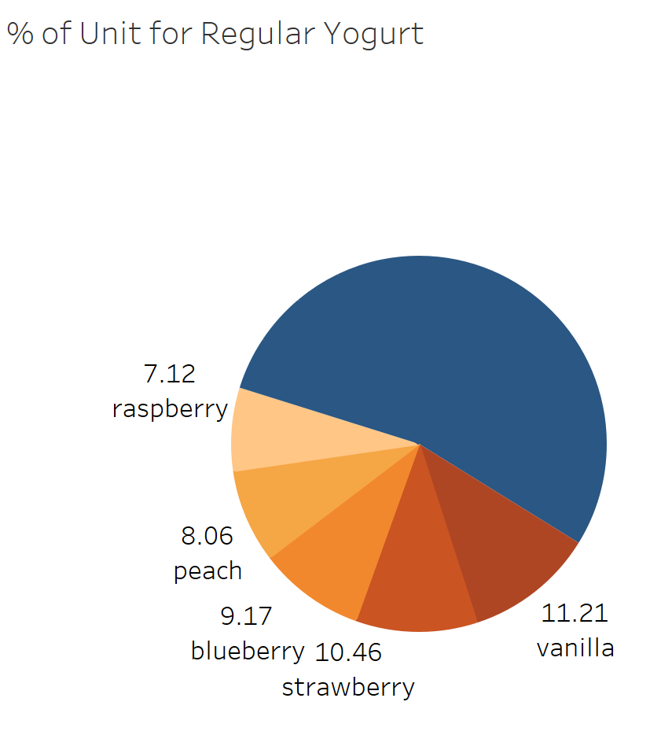
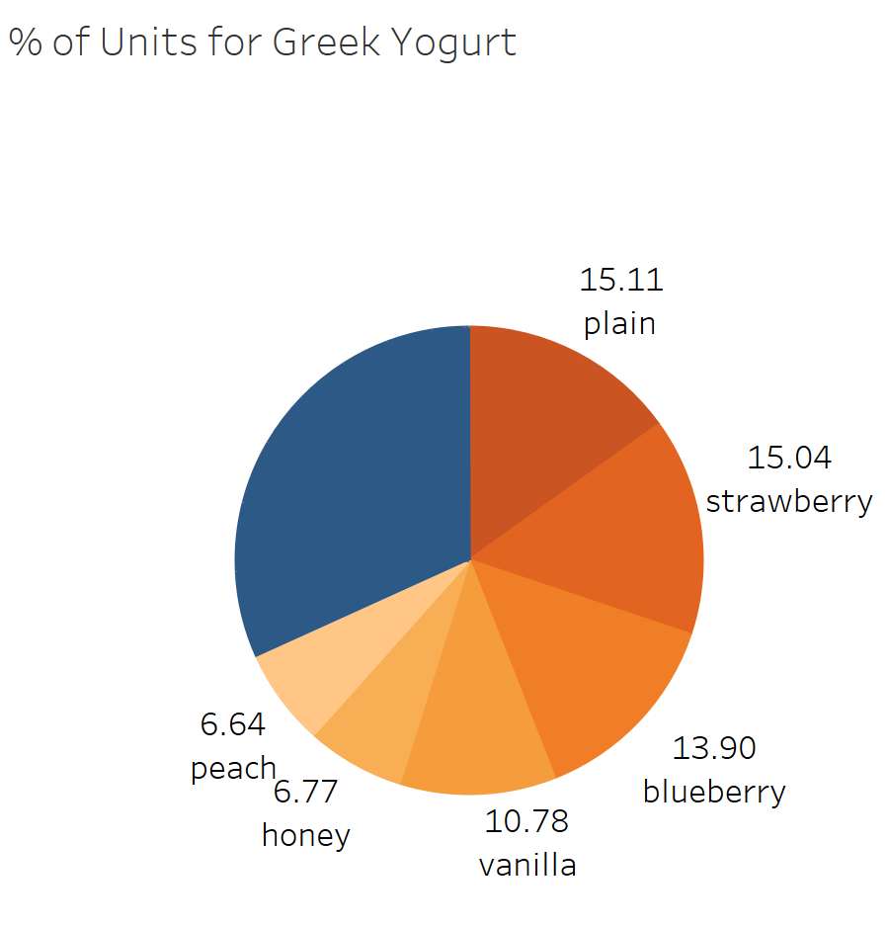
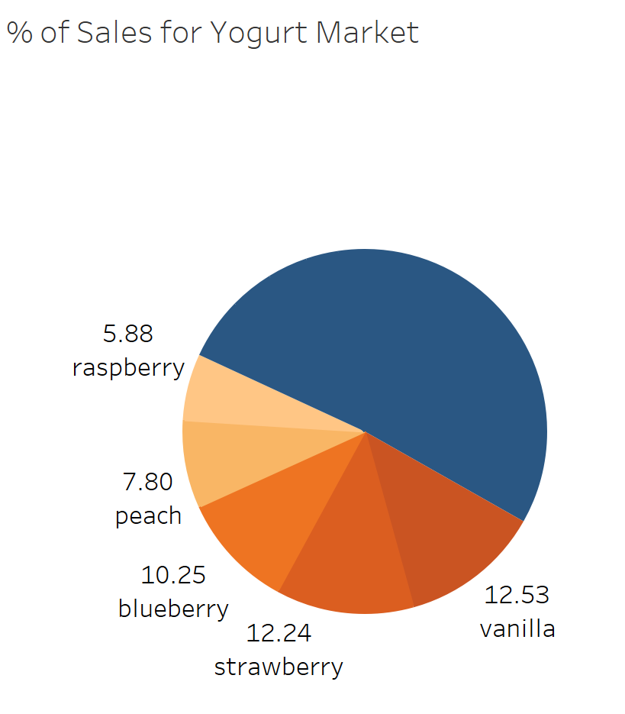
Historical Data Analysis
单击此处添加标题
Plain flavor of yogurt dominates the Greek yogurt class
Vanilla flavor of yogurt dominates the Regular yogurt class
Maximum revenue is generated by Vanilla flavor
Greek yogurts generate double the revenue compared to regular yogurts

Slide 4
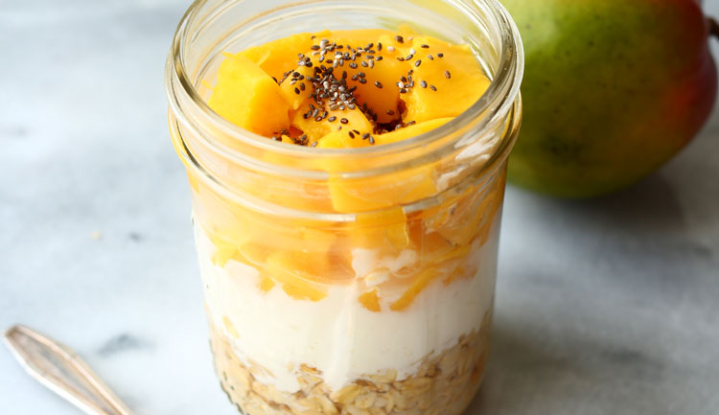
Attributes - Retailer & Survey
Flavor | zerofat | lowfat | highfat | organic | all.natural | probiotic | fiber | fob | SBS.cup | NCIT.cup
plain | 20% | 16% | 19% | 19% | 14% | 13% | 0% | 0% | 0% | 0%
strawberry | 19% | 28% | 8% | 11% | 7% | 10% | 2% | 10% | 3% | 2%
blueberry | 22% | 21% | 9% | 11% | 11% | 8% | 1% | 12% | 3% | 0%
vanilla | 19% | 25% | 15% | 18% | 7% | 14% | 2% | 0% | 0% | 1%
peach | 19% | 25% | 10% | 12% | 7% | 8% | 4% | 12% | 1% | 1%
raspberry | 18% | 27% | 10% | 10% | 10% | 14% | 0% | 10% | 0% | 0%
lemon | 27% | 18% | 23% | 9% | 9% | 0% | 0% | 14% | 0% | 0%
pomegranate | 18% | 18% | 0% | 0% | 27% | 18% | 0% | 18% | 0% | 0%
mango | 11% | 22% | 11% | 0% | 22% | 11% | 0% | 11% | 11% | 0%
pineapple | 0% | 43% | 0% | 0% | 14% | 0% | 0% | 43% | 0% | 0%
black cherry | 16% | 26% | 11% | 5% | 11% | 11% | 0% | 21% | 0% | 0%

Slide 5
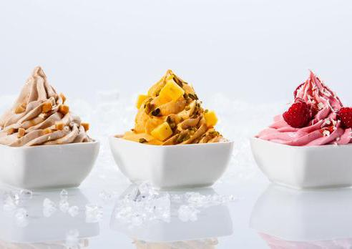
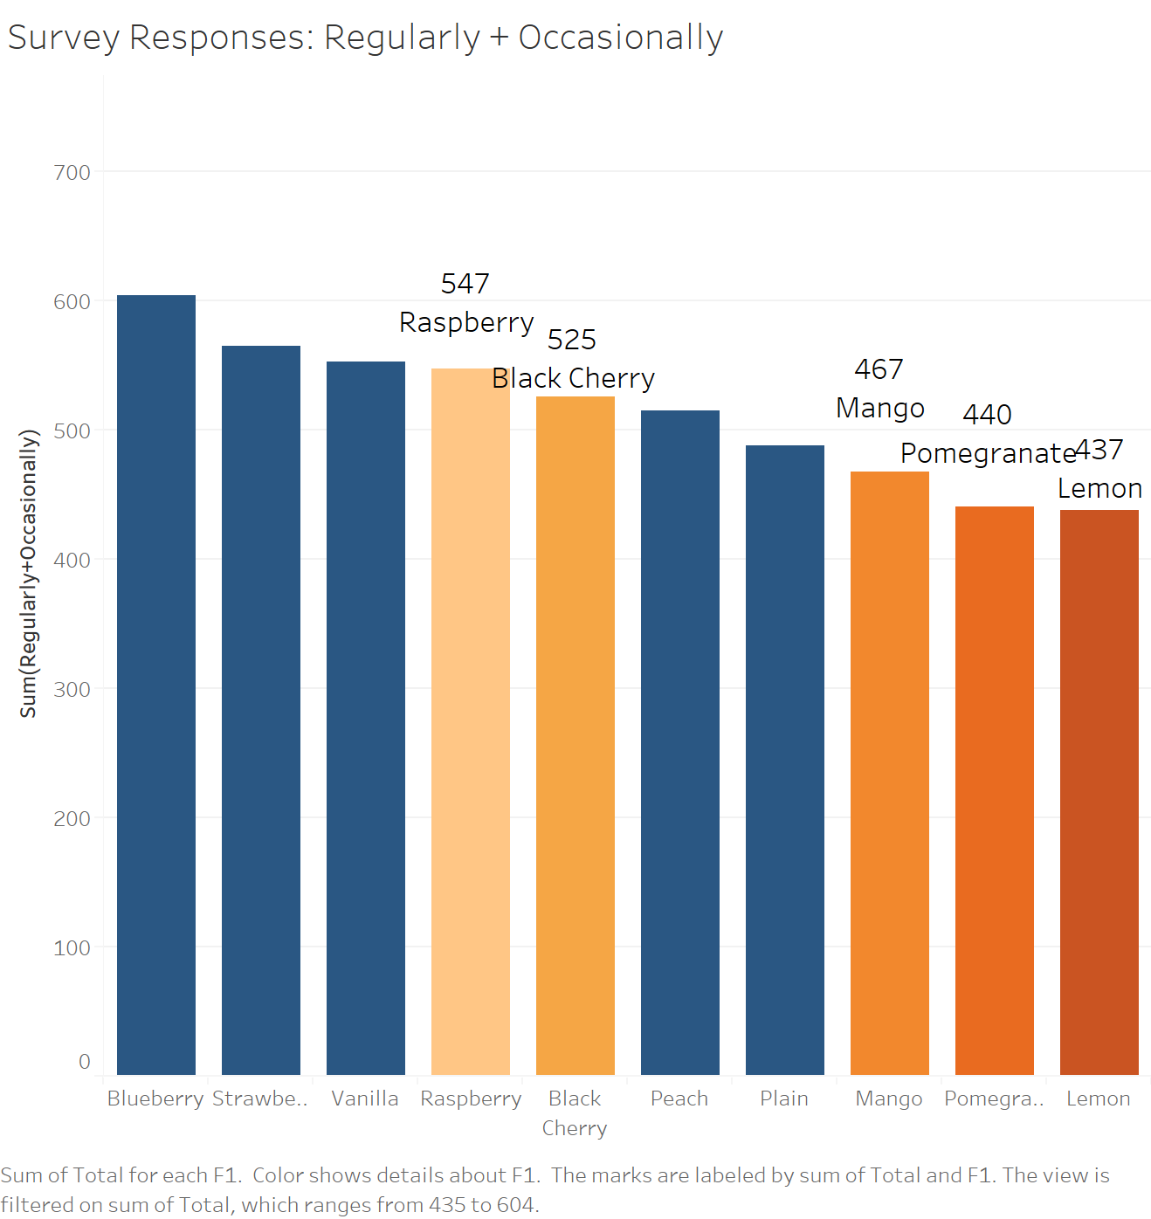
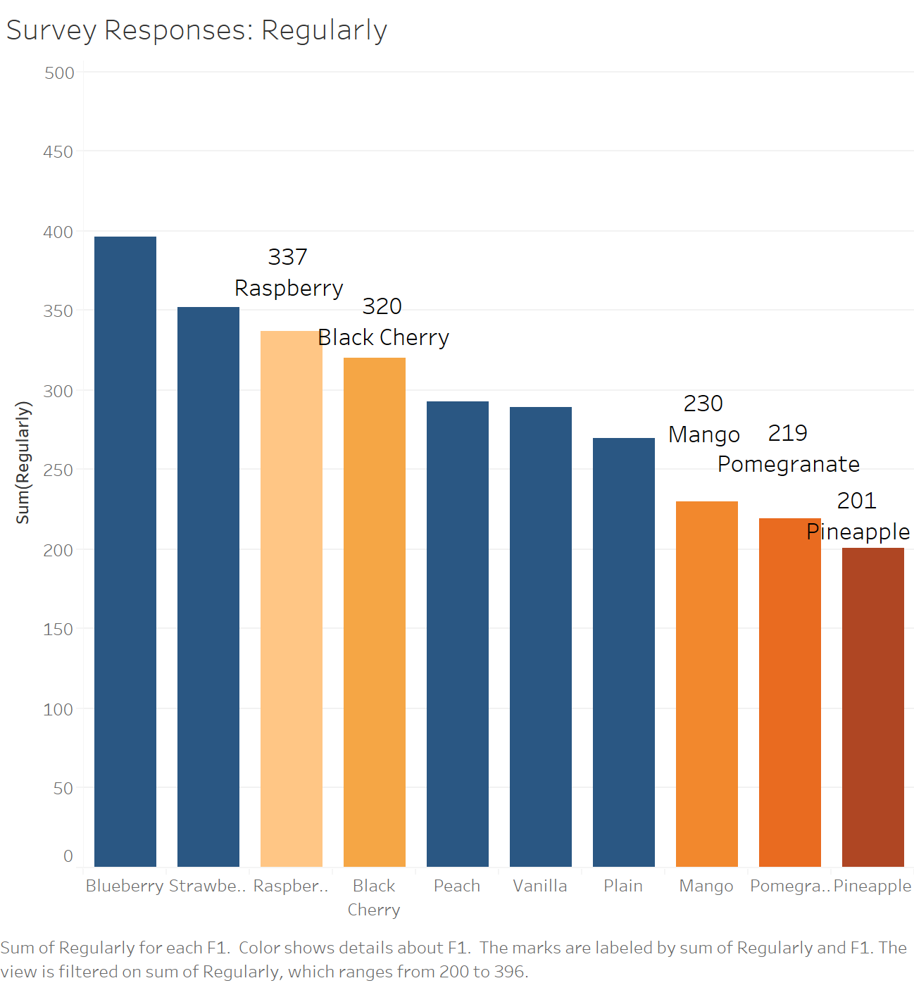
Survey Responses for Flavor Selection
Survey Responses
The number of customers who select those flavors as ‘Regularly’ or ‘Occasionally’.
Blueberry is the most favorite flavor of Greek yogurt base on the Survey data.
Top 10 flavors have been selected.

Slide 6
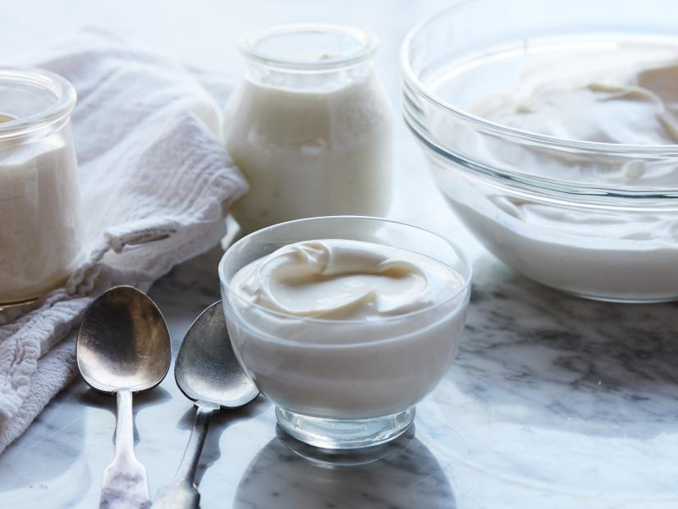
Methodology
Limitations:
The survey is not restricted to private label;
Hard to standardize choices of ‘Regularly’ and ‘Occasionally’;
The responses are yogurt-buyer biased.
Assumptions:
The situation in the whole market can be applied to our private label;
‘Regularly’ is 4 times as frequently as ‘Occasionally’;
Focus on regular-yogurt-buyers;
The customers are indifferent and will buy all better choices when provided.
Value = 1
Y
‘Regularly’?
Number of ‘Occasionally’ >= 4?
For each Customer
Y
Value = 1
Reach Analysis
N
N
Value = 0
For each Scenario
Reach = %(value=1)
Frequency Analysis
For each Customer
‘Regularly’?
Score = 1 for ‘Regularly’
Score = 0 for ‘Occasionally’ & ‘Never’
Score = 0.25 for ‘Occasionally’
Score = 0 for ‘Never’
For each Scenario
Indicator of Unit Selling = sum(score)
Y
N

Slide 7
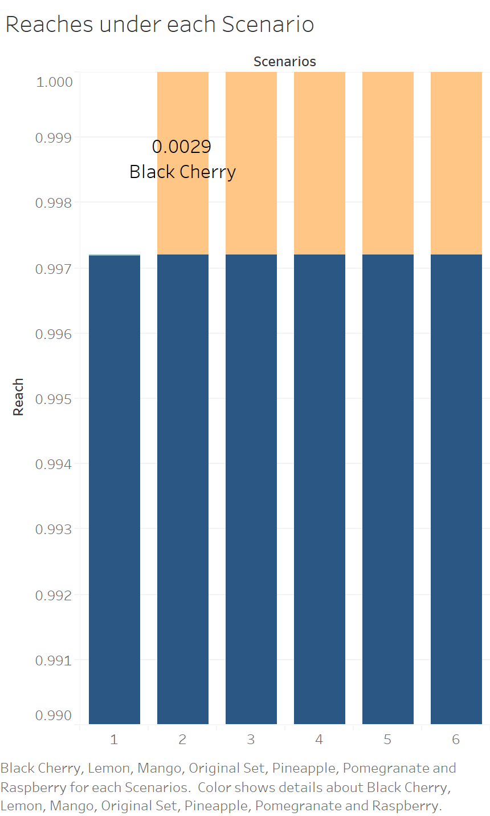
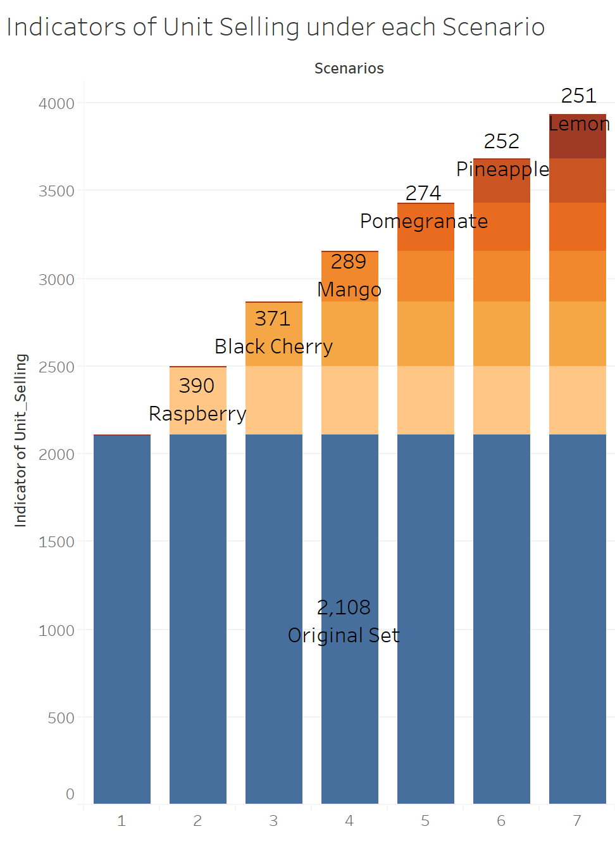
Turf Based Analysis
The original set with six existing flavors would generate reach of 0.9972, while adding ‘Black Cherry’ would increase to 1;
The original set with six existing flavors generates indicator of unit selling of 2108, while adding ‘Raspberry’, ‘Black Cherry’, ’Mango’ will increase it by a decreasing order.
To sum up, ‘Black Cherry’ is the best choice for next new flavor.

Slide 8
Thank you

Slide 9
Appendix

Slide 10
Appendix I

